Slide 2


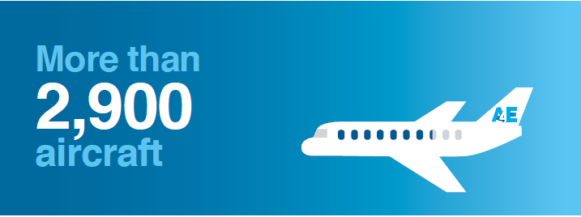

Founded in January 2016 at the Aviation Summit in Amsterdam
First association which brings low cost and network carriers together – and open for all business models

Slide 3


Airspace inefficiencies increased CO2 emissions by 5.8 per cent
Preferred flows
2019 flows
Maastricht
+30%
Karlsruhe
+27%
Marseille

Slide 4
FABEC RP3 Performance Plan does not address these topics
Lacks ambition and makes airlines pay for a service level that is not provided
Targets are not ambitious or challenging:
    Environmental targets will lead to increase emissions
    Capacity targets will allow 100 million minutes of delay
    Cost will increase without providing the service required
The incentive scheme will reward underperformance
The investment plan does not address the current airline needs

Slide 5
FABEC member states are about to approve weakest performance targets ever
NAAs should
Challenge air navigation service providers (ANSPs) to deliver the service required
Set ambitious targets to support the challenge
Promote desired behavior, improvements and best practices
Ensure that ANSPs deliver both performance and investment plan
ANSPs should
Deliver a consistent and cost-efficient service
Focus on providing operational and cost benefits in all performance areas
Plan, consult and justify investments based on airspace users needs
Invest as agreed
Ensure appropriate staffing resources and adapt to changing requirements

Slide 6
Actions are needed to keep aviation sustainable - today
Invest the budget as planned to upgrade operations, technology and workforce to tackle the current capacity shortages where it is needed
Urgently address the current air traffic controllers shortfall
Address the hotspots identified by the airspace architecture study immediately
Make airspace restructuring and cross border cooperation a priority
Learn from the past and apply best practices
Answer to the digitalization challenge and prepare for new business models
Help to unlock environmental improvements of aviation by allowing the full potential of airline investments to materialize
Support airlines in their efforts to avoid double or triple burden on emissions

Slide 7
Thank You

